Slide 1
Pepperdine FinTech Bootcamp
Final Project
Andrew Garcia-Schanz, Anthony Finocchiaro, Frank Lucas, Christian Perez
Using Twitter & Alpaca API for High Frequency Algorithmic Trading
Refined with Neural Network Learning
Notes:
Good Morning All, thank you for joining us today for our team’s presentation.
Our team consists of Andrew Garcia-Schanz, Frank Lucas, Christian Perez, and myself Anthony Finocchiaro.
Next Slide please

Slide 2
Brief Overview
Automated Trading Platform
Remove the irrational and emotional aspect of trading.
Creates a clinical approach to investing based on predetermined parameters.
Eliminates execution risk of submitting an order in real time (Human Error)
Leveraging Top Fintweet Users
These select twitter users create high volume & volatility resulting in strong reach amongst retail investors.
This creates an identifiable momentum indicator for an automated trading platform to capture greater swings in equity pricing than conducting solo due diligence.
More data points for an informed trade
Notes:
Today we will be presenting our project on our automated trading platform.
One of the biggest intangible benefits to automated trading is the removal of the emotional element of trading.
The removal of these emotions creates a clinical approach that is dispassionate and does not let bad data, aka irrational human elements enter into the equation. Another downside of non-automated trading is the human element of executing either an position opening or closing in real time. This may seem nominal, but when monitoring multiple positions throughout the day, it becomes very easy for an oversight to throw off a day’s worth of trading. Our platform seeks to eliminate these risks.
Automated trading is hardly groundbreaking with many high frequency trading firms such as Citadel, Point 72, and Renaissance Tech creating billion dollar brands around this strategy.
However, our automated trading platform contains a unique value add in that it constantly monitors highly active platforms for proprietary indicators of when to open and exit an equity’s position.
We achieve this by leveraging two API’s, Twitter and Alpaca. Each API performs a specific task for our end result. Which we will discuss more in depth shortly.

Slide 3



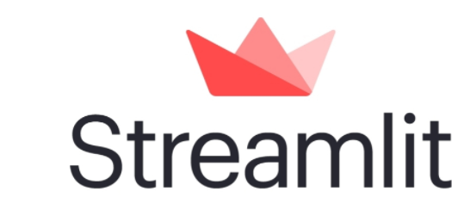
Elemental Purposes
Twitter API
Alpaca API
Final Outcome
Collect data from real time twitter posts.
Analyze trends and sentiments
Mirror positions from users with exponentially greater followers
Algorithmic Trading Execution
Write and execute Stop Loss and Profit Taking
Entries based on user specific tweets and polarity
High Frequency Trading
Maximized Profits
Minimized Losses
StreamLit API
To visually highlight our code in what the end results are
Notes:
Twitter’s API is the input data, if you will. Over the past 18 months retail trading has seen an exponential increase in daily volume. Moving it to the second highest category of daily volume within the markets, only behind institutional market makers.
With this volume comes a treasure trove of data that is openly published via twitter. Our team has selected what we deem the top 5 twitter users to follow and mirror there trading. This is important because of each user’s reach and their ability to influence retail traders in opening and closing positions. Our platform pulls each tweet from the designated user, analyzes if there is a position to be opened, and from their automatically executes a buy order to then be able to ride the swing trade momentum that is created by retail investors piling into the published position. The code is then pushed through Alpaca’s API (our current brokerage of choice) to then successfully open and close positions based on predetermined stop losses and take profit percentages. We will be showcasing the trades later in this presentation.
We do know that not all tweets and trades will be created. Within Alpaca we have a polarity offset to only execute trades that rate at a .3% range and above. This assures that high quality inputs are resulting in profitable, high quality outputs.
This polarity, coupled with our predetermined stop loss and take profit percentages assures that we are in the equity quickly enough to make a healthy profit, but exit the equity soon enough to account for a decline in volume and opportunity cost for being invested in one position. Our team feels that a take profit at 10% is healthy and sustainable on a long term basis as this platform will be operational during market hours and should execute dozens of trades daily.
Next we’ll pass it on to Frank to discuss the Twitter API more in depth.

Slide 4

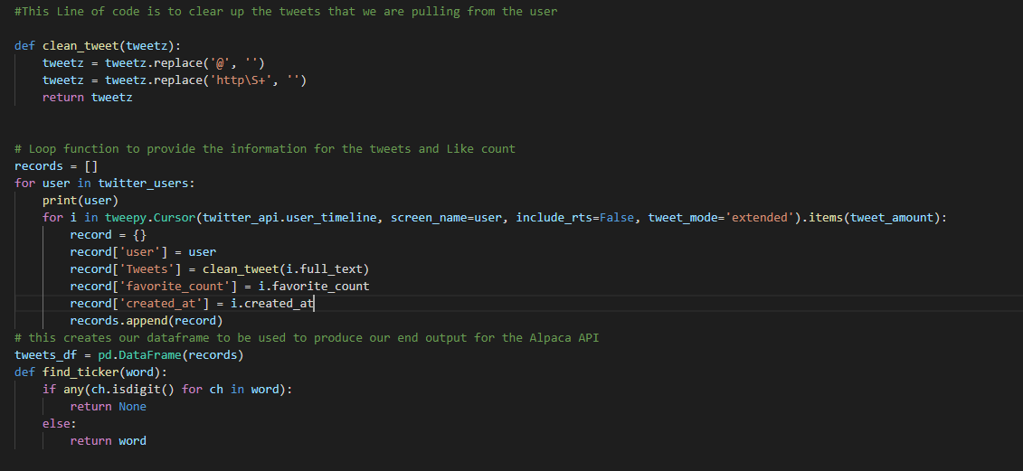
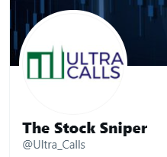
Twitter Coding/API In-Depth
Stock Selection
User specific tweets (Zack Morris, Will Meade, PJ Matlock, Gary, unusual_whales)
Ultra_Calls was our best user to test our sentiment analysis due to activity

Slide 5
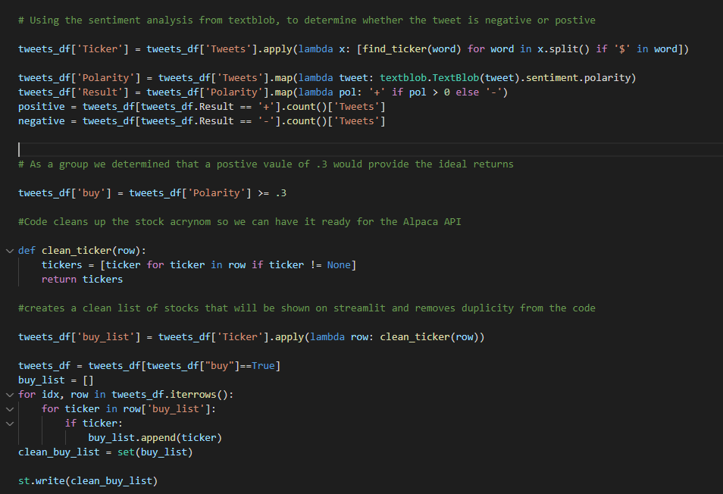

Twitter Coding/API In-Depth
Stock Selection
Polarity from the tweet of the user
Selected positions based off sentiment and user tweets

Slide 6

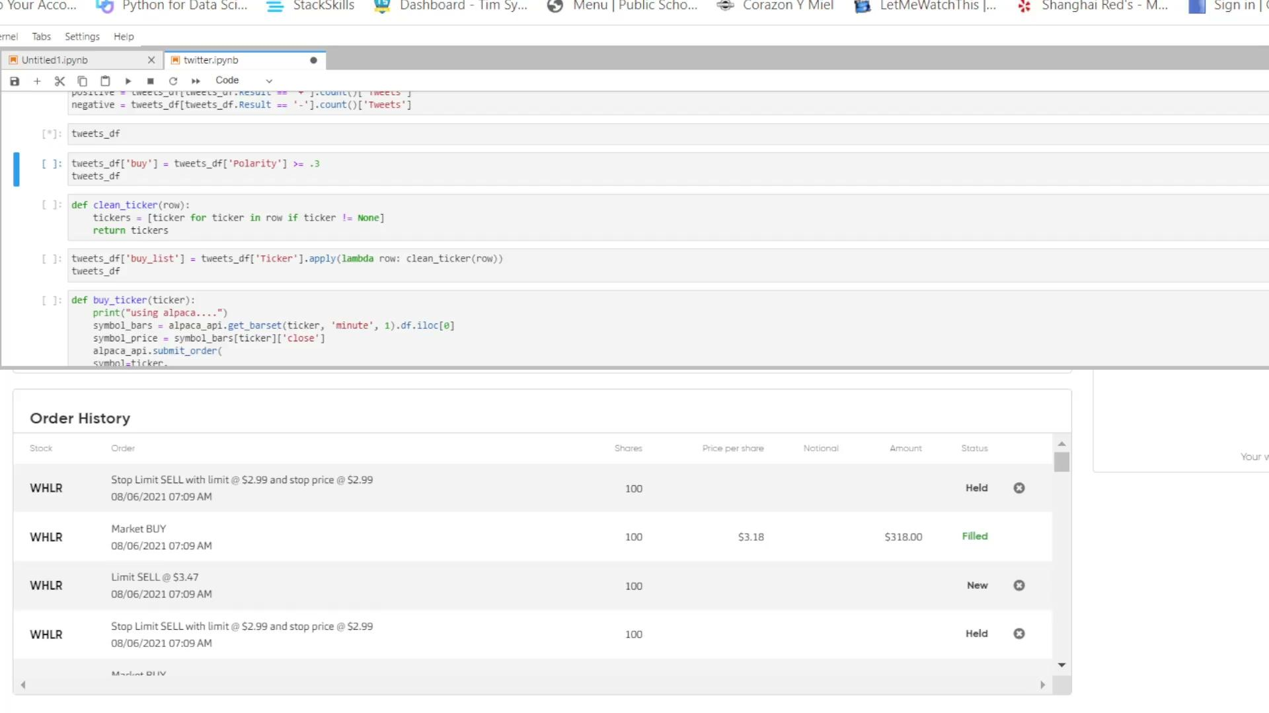
Alpaca Coding/API In-Depth
Market Orders
Selected from Twitter API
10% defined Profit Taking
5% Stop Loss

Slide 7
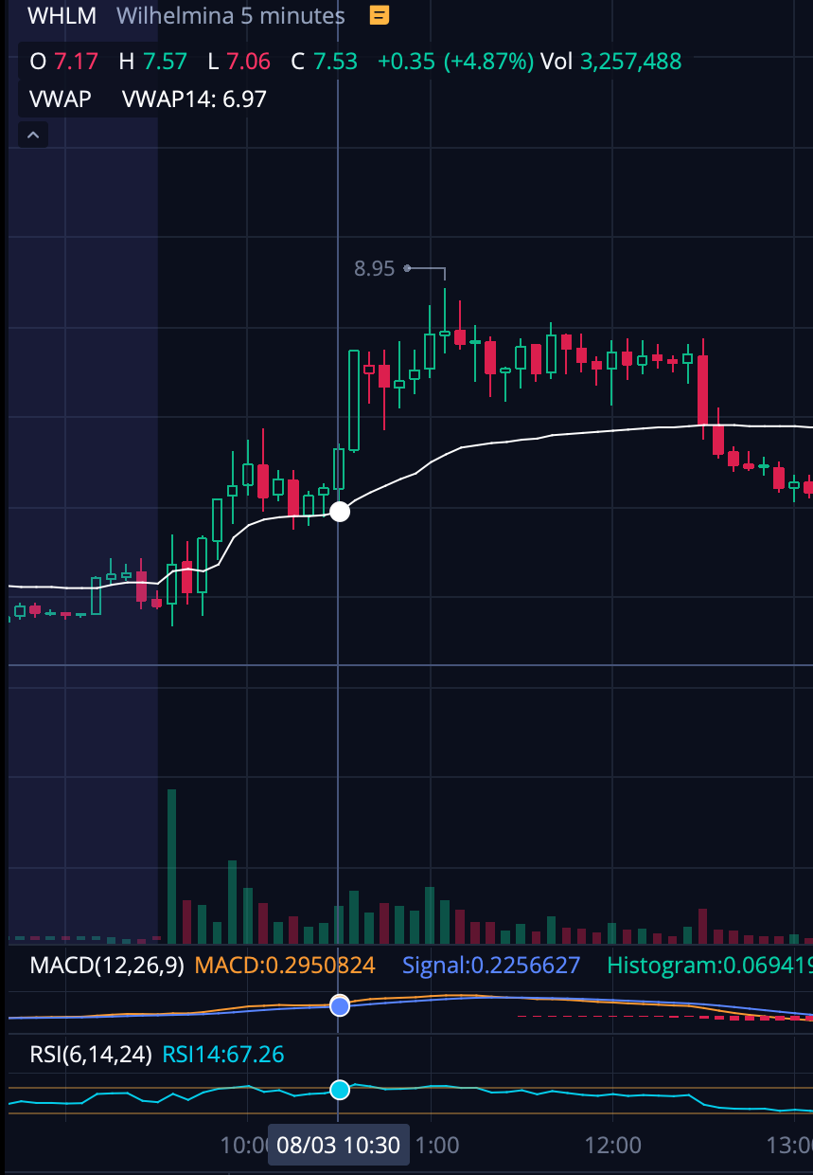
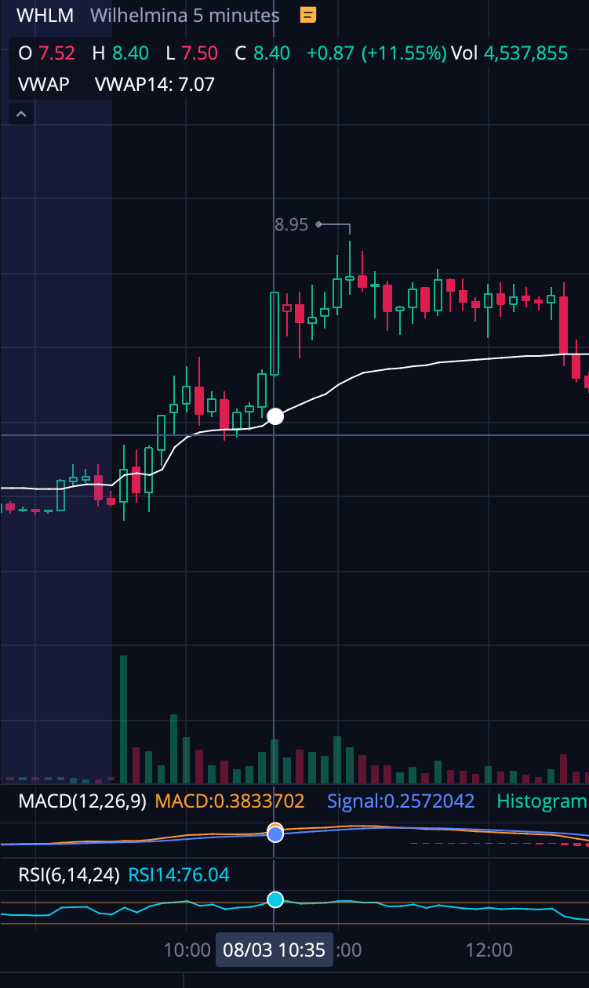
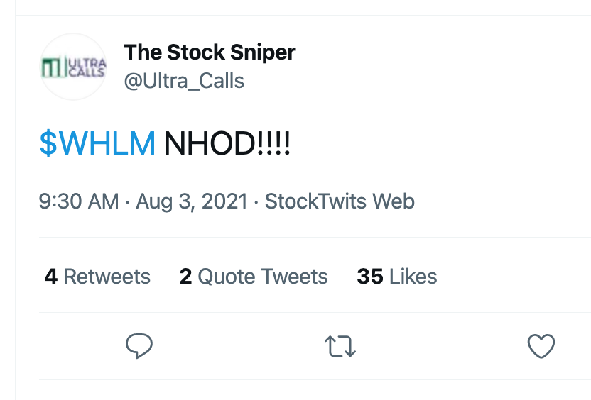
Putting it All Together

Slide 8
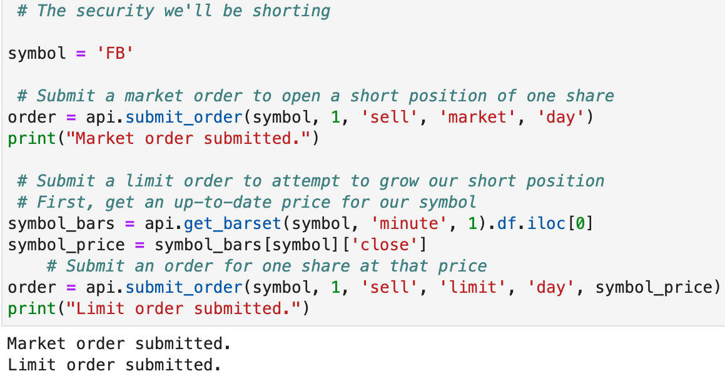
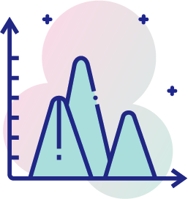

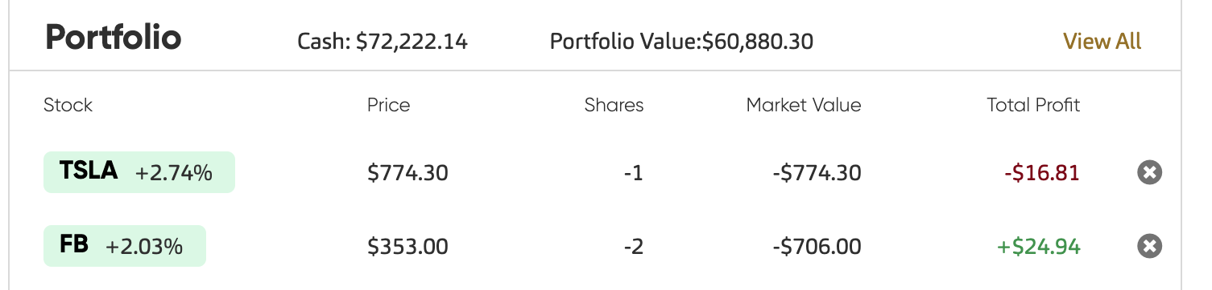
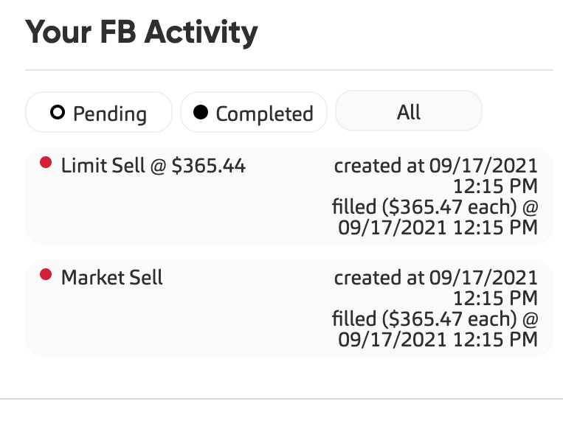
Once a Bull, Now a Bear
Go short instead of long
Open a short position based on twitter user tweets
Creates more opportunities for profit on downtrend days
Unfortunately, not every stock can be shorted

Slide 9
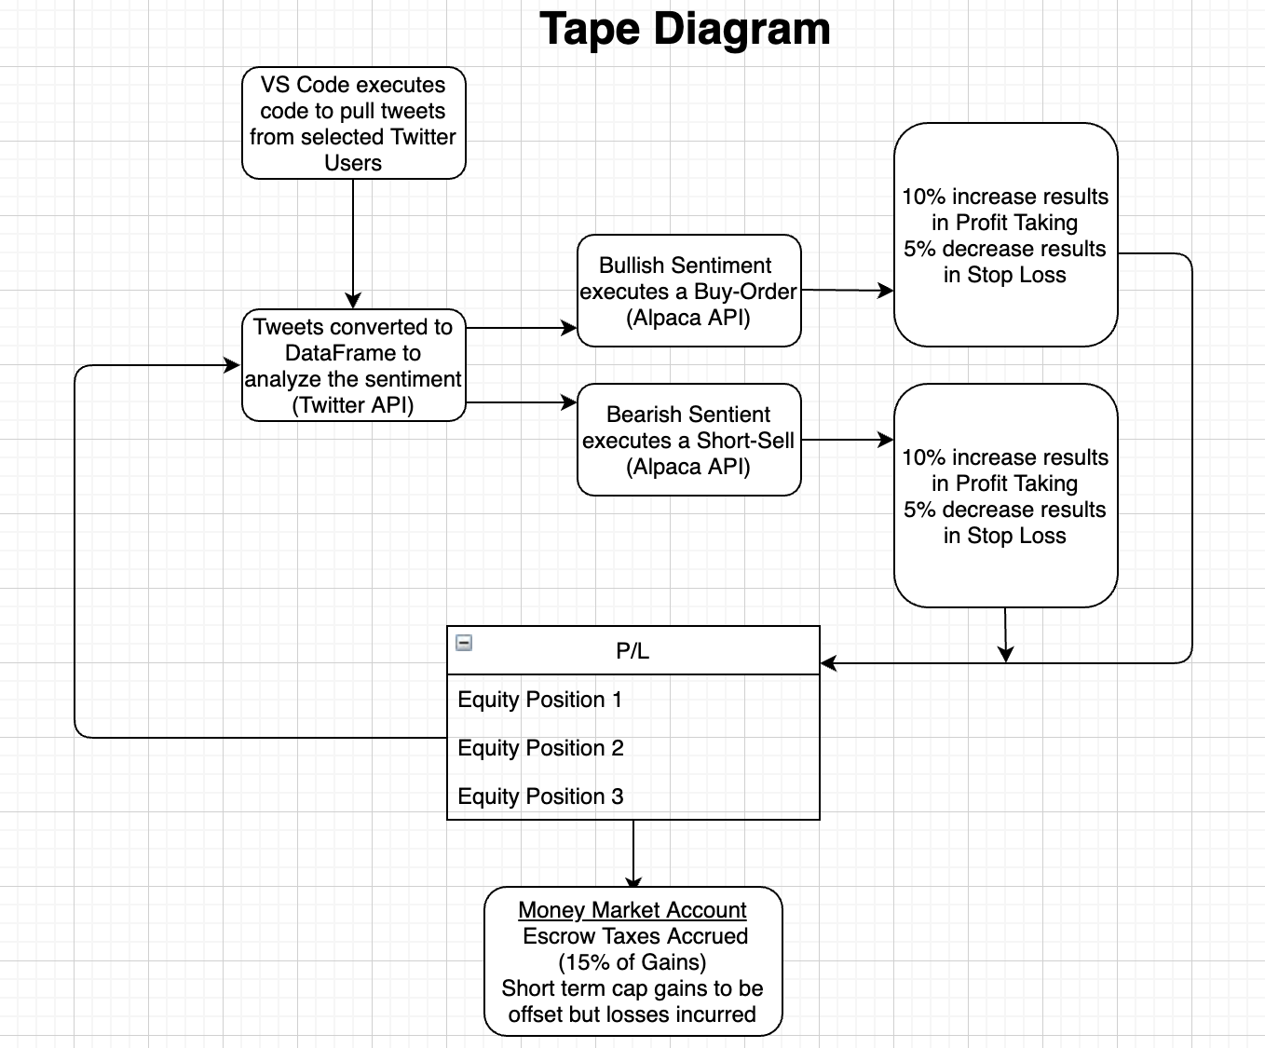
Tape Diagram

Slide 10
Tape Application
Desktop Application
Streamlit mergers Alpaca and Twitter API to execute trades
Allows Users to customize size order, dollar amount, and priorities
Simplifies execution of code across an online platform.
Mobile Device Application
Take your desktop app with you anywhere
Adjust your FURU inputs as users increase in skill level
Analyze your data in real time to improve overall market performance

Slide 11

Tape Desktop - Demo
Please review the input and execution of Tape’s Desktop Trading application

Slide 12

Tape Mobile App - Demo
Play with Tape Mobile

Slide 13
Looking Ahead...

Slide 14
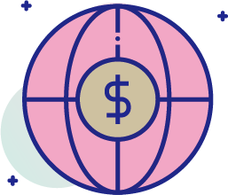
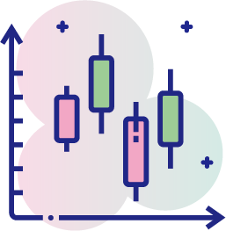
Further Development
Desktop Application
Desktop Application enabled for other Broker/Dealer APIs:
TD Ameritrade, WeBull, Fidelity
Clearer and unique branding
Funding would allow Lambda/AWS execution automation
Grow to scale to become an impactful and relevant RoboAdvisor
Mobile Device Application
Mobile Application enabled for other Broker/Dealer APIs:
TD Ameritrade, WeBull, Fidelity
Eradicate dead space within the App
Enable Alpaca crypto trading

